Slide 1
Exploratory data analysis

Slide 2
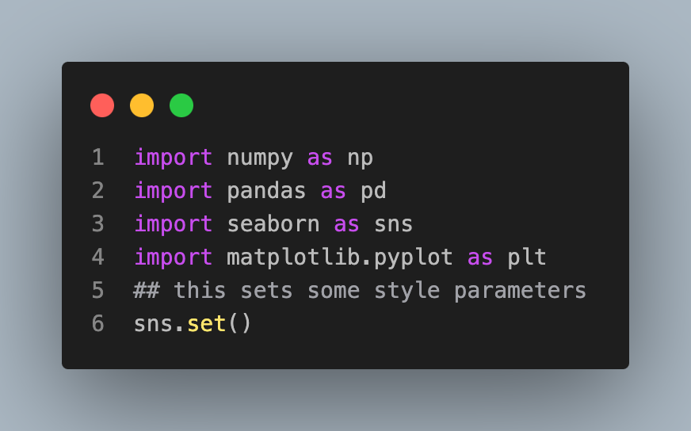
Initial setup

Slide 3
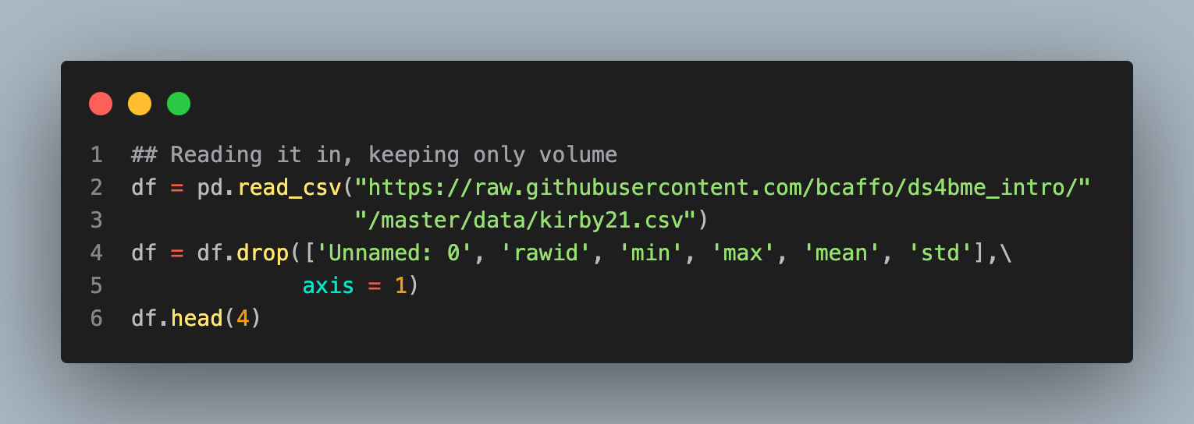
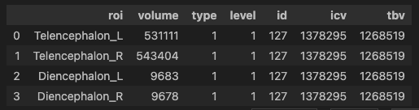
First let's download the data. Then we'll read it in and drop some columns that aren't needed for this analysis.

Slide 4
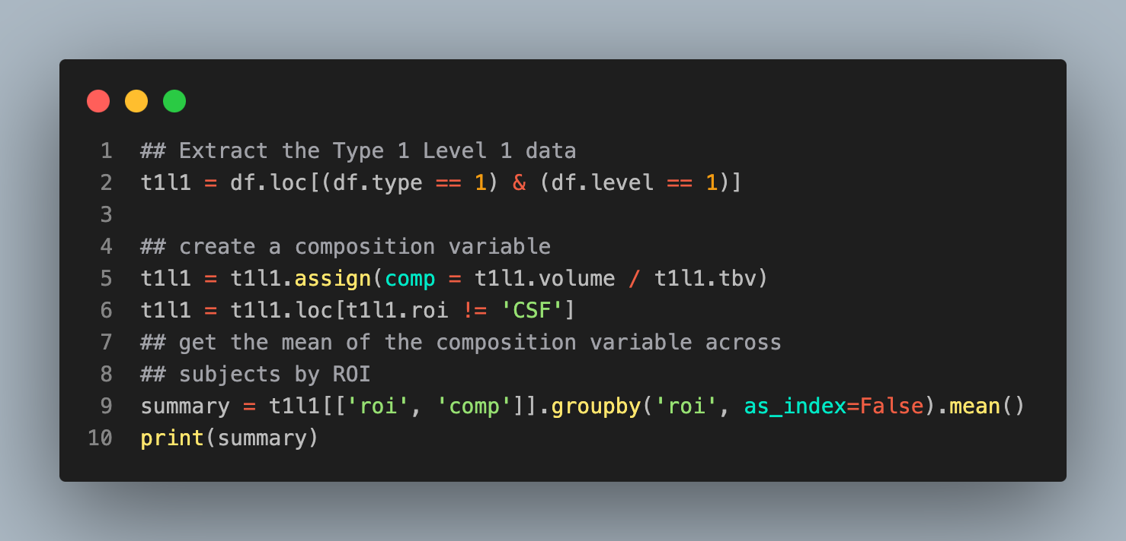
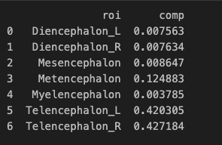
Let's look at the Type 1 Level 1 data and create a variable called comp which is brain composition, defined as the regional volumes over total brain volume. We'll do this by selecting roi and comp then grouping by roi and taking the mean of the compositions.

Slide 5
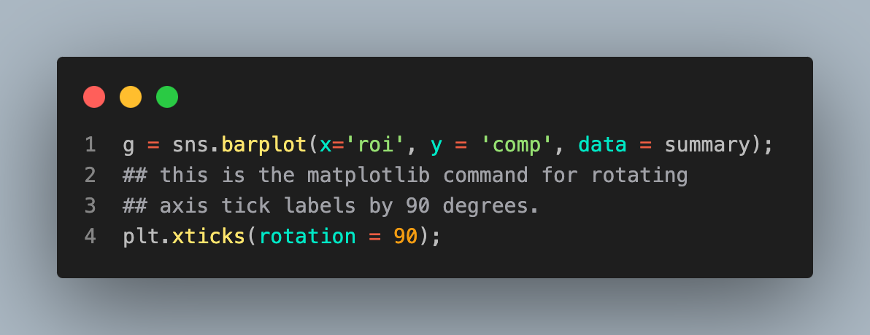
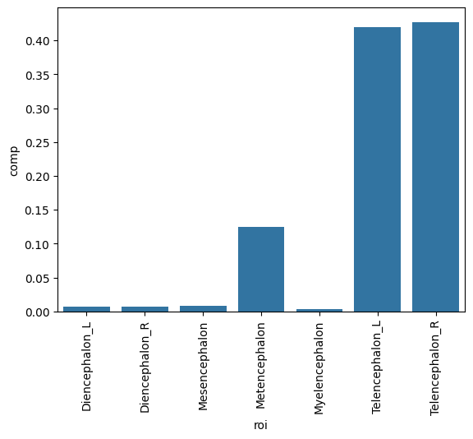
Creating a plot
OK, let's try our first plot, a seaborn bar plot.

Slide 6
Notice
Unfortunately, seaborn doesn't have a stacked bar chart. However, pandas does have one built in. To do this, however, we have to create a version of the data with ROIs as the columns. This is done with a pivot statement.

Slide 7
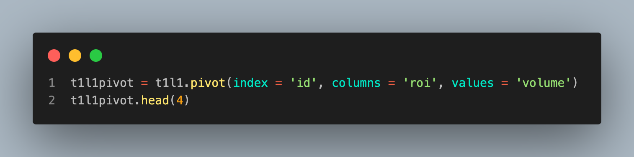
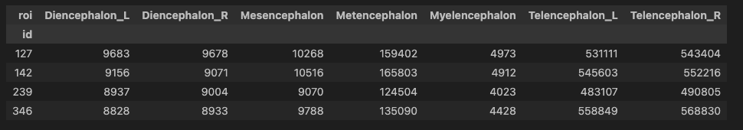

Slide 8
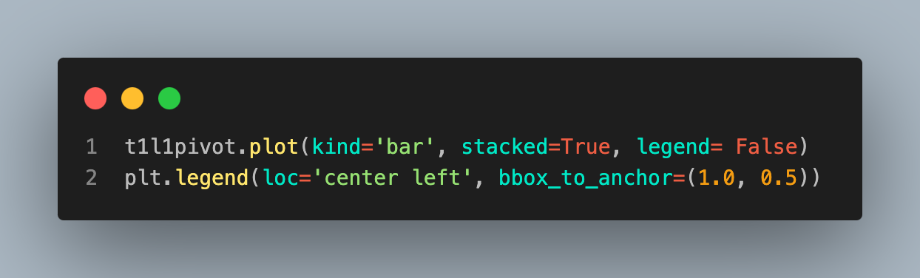
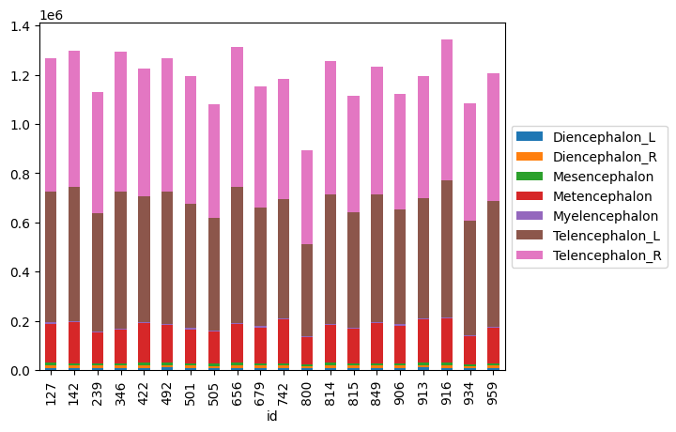

Slide 9
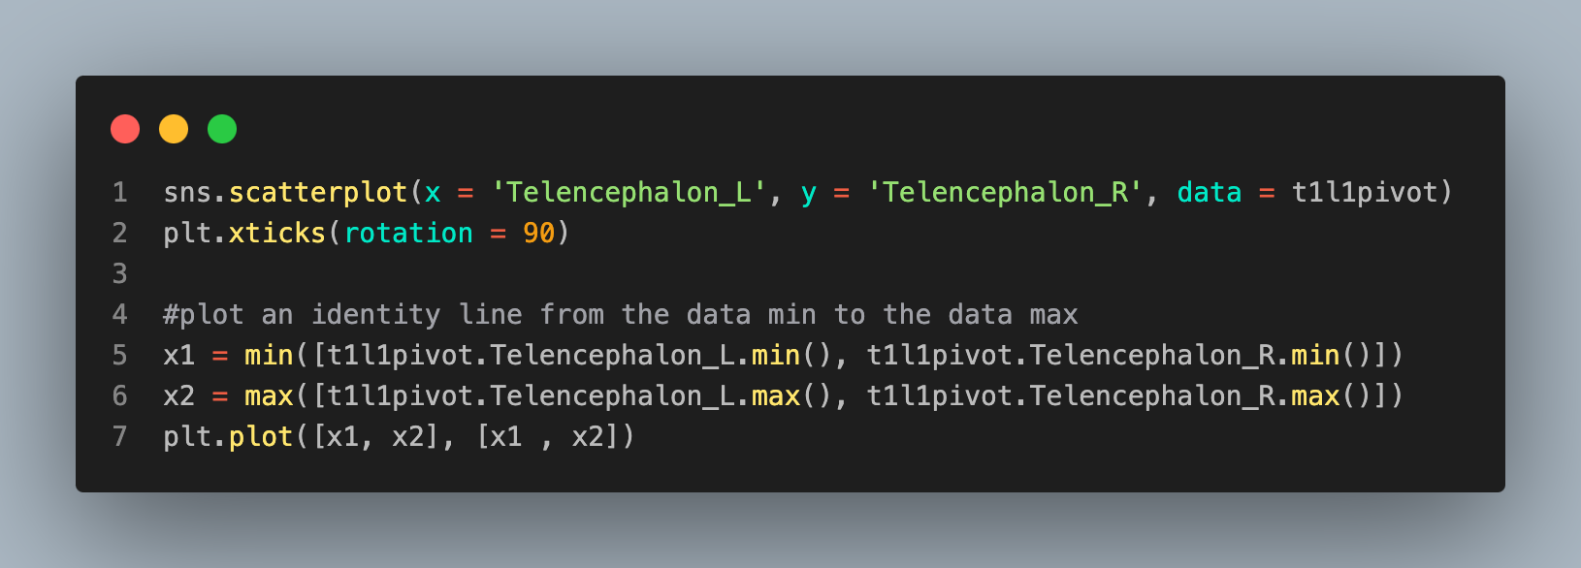
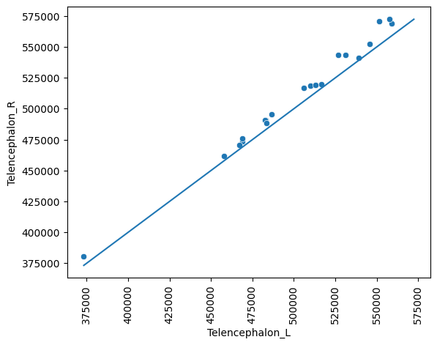
Scatterplot
Let's do some scatterplots. Let's look at bilateral symmetry in the telencephalon.

Slide 10
This plot has the issue that there's a lot of blank space. This is often addressed via a mean difference plot. This plot shows (X+Y) / 2 versus (X-y). This is basically just rotating the plot above by 45 degrees to get rid of all the blank space around the diagonal line. Alternatively, you could plot (log(x) + log(y)) / 2 versus log(X) - log(Y). This plots the log of the geometric mean of the two observations versus the log of their ratio. Sometimes people use log base 2 or log base 10.

Slide 11
